Slide 1
Translation - 2
Miss L
Year 7

Slide 2
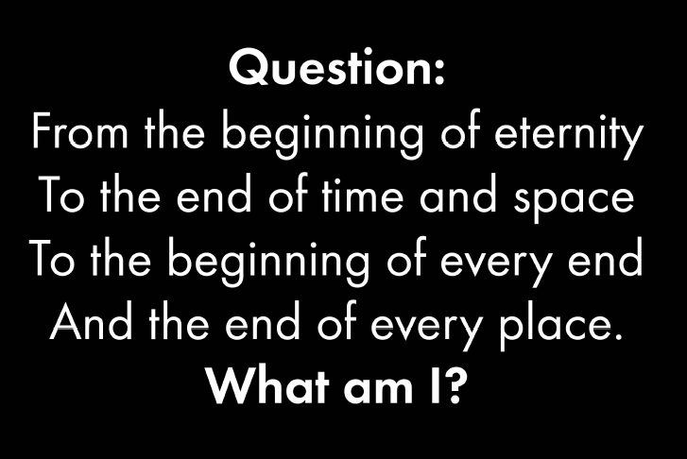

Slide 3


Slide 4

Quick-Write
Describe what translation is?
WICOR

Slide 5
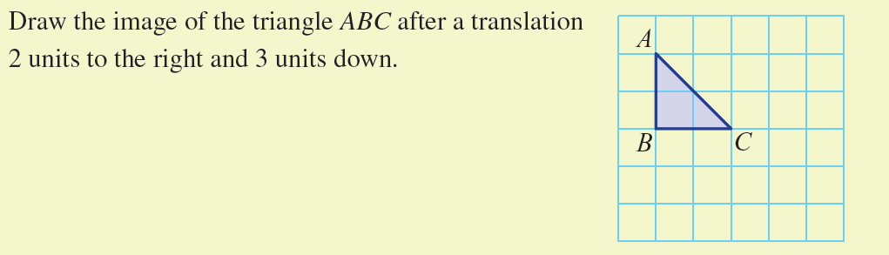
From last lesson

Slide 6
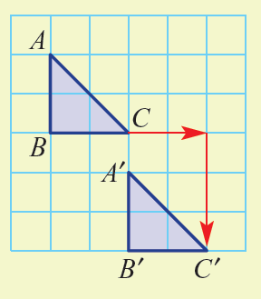

Slide 7

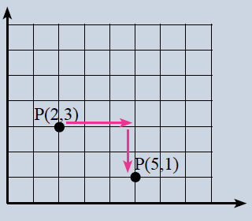

24
7
30
Translations
Date:
EQ – How can we describe coordinate translations?
What is a coordinate translation?
Instead of translating a shape we will translate the coordinate and write the new coordinate down
Example:
New Coordinates: P(5,1)

Slide 8


Slide 9
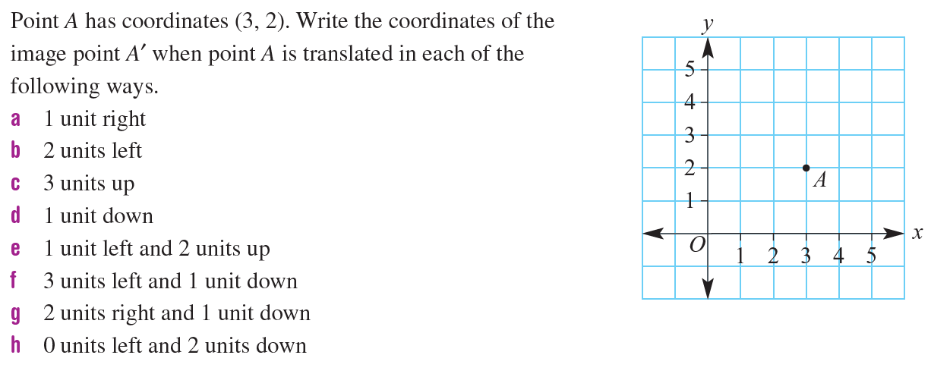
Practice
Notes:
Guide students through the question.
Option 2: Dot plots handout (Scaffolded for kids who may need extra help)

Slide 10
Task
Complete the worksheet
Then complete the drawing of the unknown figure……
Notes:
Guide students through the question.
Option 2: Dot plots handout (Scaffolded for kids who may need extra help)

